Slide 1
Polymorphism in C++
Prepared By: Dadhi R. Ghimire
Lecturer, PATAN Multiple Campus
Tribhuvan University

Slide 2
Polymorphism
The word polymorphism means having many forms.
In simple words, we can define polymorphism as the ability of a message to be displayed in more than one form.
In C++ polymorphism is mainly divided into two types:
Compile time Polymorphism
Runtime Polymorphism

Slide 3
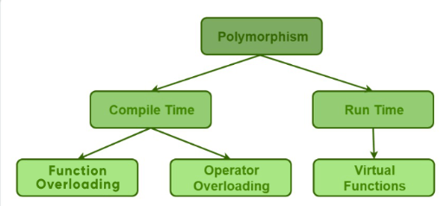
Polymorphism

Slide 4
Compile Time Polymorphism
Function Overloading: When there are multiple functions with same name but different parameters then these functions are said to be overloaded. Functions can be overloaded by change in number of arguments or/and change in type of arguments

Slide 5
Compile Time Polymorphism
Operator Overloading: C++ also provide option to overload operators. For example, we can make the operator (‘+’) for string class to concatenate two strings. We know that this is the addition operator whose task is to add two operands. So a single operator ‘+’ when placed between integer operands , adds them and when placed between string operands, concatenates them.

Slide 6
Runtime Polymorphism
This type of polymorphism is achieved by Function Overriding and Virtual Function.
Function overriding on the other hand occurs when a derived class has a definition for one of the member functions of the base class. That base function is said to be overridden.

Slide 7
Virtual Function
A virtual function is a member function which is declared in the base class using the keyword virtual and is re-defined (Overriden) by the derived class.

Slide 8
Function Overriding without Virtual Function
using namespace std;
class Shape
{
public:
Shape(int l, int w)
{
length = l;
width = w;
}
int get_Area()
{
cout << "This is call to parent class area\n";
return 1; }
protected:
int length, width;
};
class Square : public Shape
{
public:
Square(int l = 0, int w = 0) : Shape(l, w)
{
} int get_Area() {
cout << "Square area: " << length * width << '\n';
return (length * width);
}
};
class Rectangle : public Shape
{
public:
Rectangle(int l = 0, int w = 0) : Shape(l, w)
{
} int get_Area()
{
cout << "Rectangle area: " << length * width << '\n';
return (length * width); }
};
int main()
{
Shape* s;
Square sq(5, 5);
Rectangle rec(4, 5);
s = &sq;
s->get_Area();
s = &rec;
s->get_Area();
return 0;
}

Slide 9
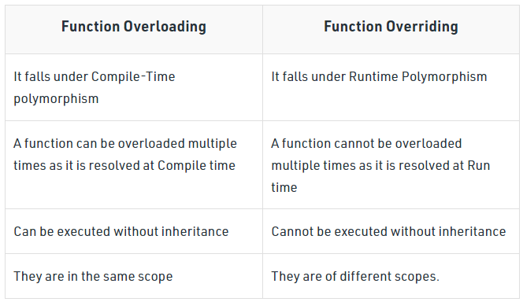
Function Overloading VS Overriding

Slide 10
Abstract Class
When the objects of base class are never instantiated, such a class is called abstract base class or simply or simply abstract class. Such a class only exists to act as a parent of derived classes from which objects are instantiated. It may also provide interface for class hierarchy.
To make a class abstract so that object instantiation is not allowed and derivation of child classes are allowed, at least one pure virtual function should be placed in the class.

Slide 11
Virtual Function and Pure Virtual Functions
Virtual Function in C++ A virtual function is a member function which is declared within a base class with keyword virtual and is re-defined(Overridden) by a derived class. When you refer to a derived class object using a pointer or a reference to the base class, you can call a virtual function for that object and execute the derived class’s version of the function.
Pure Virtual Functions in C++ A pure virtual function (or abstract function) in C++ is a virtual function for which we don’t have an implementation, we only declare it. A pure virtual function is declared by assigning 0 (=0) in the declaration.

Slide 12

Pure Virtual Function
A pure virtual function is one with the expression = 0 is added to the declaration of virtual function
Here class A become abstract since there is presence of pure virtual function show ( ). The expression = 0 has no any other meaning the equal sign = 0 does not assign 0 to function show ().

Slide 13
Pure Virtual Function
A pure virtual function has following properties:
A pure virtual function has no implementation in the base class.
It acts as an empty bucket (virtual function is partially filled bucket) that the derived class are supposed to fill it.
A pure virtual function can be invoked by its derived class.

Slide 14
Pure Virtual Function
//pure virtual function
#include<iostream.h>
#include<conio.h>
class Base
{
public:
virtual void show()=0;//pure virtual function
};
class Derv1: public Base
{
public:
void show()
{cout<<"\n I am Derv1 class";}
};
class Derv2: public Base
{
public:
void show()
{cout<<"\n I am Derv2 class";}
};
void main()
{
Derv1 dv1;
Derv2 dv2;
Base *ptr;//pointer to base class
ptr=&dv1;//address of dv1 in pointer
ptr->show();//called from Derv1
ptr=&dv2;
ptr->show();//called from Dev2
getch();
}

Slide 15
Pure Virtual Function
The pure virtual function in the base class must be overridden in all its derived class from which we want to instantiate objects. If a class doesn't override pure virtual function, it itself becomes abstract and objects cannot be instantiated.

Slide 16
Array of Pointers to Base class objects
//array of pointers to base class object
#include<iostream.h>
#include<conio.h>
class Base
{
public:
virtual void show()=0 ; // pure virtual function
};
class Derived1 : public Base
{
public :
void show() { cout <<" Derived1 \n"; }
};
class Derived2 : public Base // derived class 2
{
public:
void show() { cout <<" Derived2 \n" ; }
};
class Derived3 : public Base
{
public:
void show() { cout <<" Derived3 \n" ; }
};
class Derived4 : public Base
{
public:
void show() { cout <<" Derived4 \n" ; }
};
void main()
{
// Base baseobj ; // can't make object of abstract class
Derived1 dv1 ; // object of derived1
Derived2 dv2 ; // object of derived2.
Derived3 dv3 ;
Derived4 dv4 ;
Base *ptr[]={&dv1,&dv2,&dv3, &dv4} ;// array of ptr of base //class.
cout<<"Calling functions..."<<endl;
for(int i=0;i<4;i++)
ptr[i]->show();
getch();
}

Slide 17
Virtual destructors
Since destructors are member functions, they can be made virtual with placing keyword virtual before it. The syntax is
virtual ~ classname ( ) ; // virtual destructor.
The destructor in base class should always be virtual. If we use delete with a base class object to destroy the derived class object, then the delete calls the member function destructor for base class. This causes the base class object to be destroyed. Hence making destructor of base class virtual, we can prevent such miss-operation.

Slide 18
Example
#include<iostream.h>
class Base
{
public:
~Base ( ) ; // non virtual
//virtual ~Base()
{cout<<"Base Destryed\n";}
};
class Derv1:public Base
{
public:
~Derv1()
{
cout<<"Derived1 destroyed\n";
}
};
class Derv2:public Base
{
public:
~Derv2()
{
cout<<"Derived2 destroyed\n";
}
};
void main()
{
Base * pBase = new Derv1;
delete pBase;
}

Slide 19
'this' pointer
The member functions of every object have access to a magic pointer named 'this' which points to the object itself. The this pointer is implicitly defined in each member function.
Every member function of a class is born with a pointer called this. Which points to the object with which the member function is associated.
When member function is invoked, it comes into existence with the value of this set to the address of the object for which it is called.

Slide 20
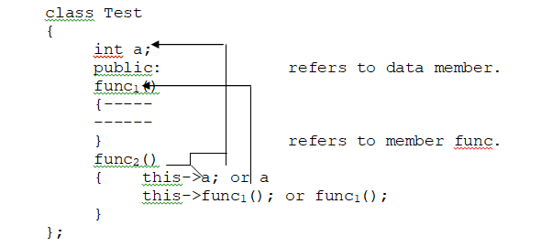
'this' pointer

Slide 21
Example
#include<iostream.h>
class Test
{
int a;
public:
void setdata(int x)
{ a=x; //or this->a=x;
cout<<"Address of my object is :"<<this<<endl;
}
void showdata()
{ // normal way.
cout<<"Data accessed normally:"<<a<<endl;
cout<<"Address of object in showdata():"
<<this<endl;
// data access through this
cout<<"\nthis->a:"<<this->a;
}
};
void main()
{
Test myobj;
myobj.setdata(20);
myobj.showdata();
}

Slide 22
‘this’ for returning values
For returning values from member functions, this can play important role. When an object is local to a function, the object will be destroyed when function terminates. So it is necessary for a more permanent object while returning it by reference.
Consider a function add() for addition of two complex object called as
c₃=c₁. add(c₂); Where c₁, c_{2,} c₃ are complex no. objects.

Slide 23
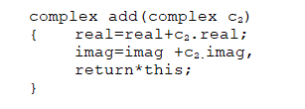
‘this’ for returning values

Slide 24
Lab Exercise
Write a program to create a class shape with functions to find the area of the shapes and display the names of the shapes and other essential components of the class. Create derived classes circle, rectangle, and trapezoid each having overriding functions area() and display(). Write a suitable program to illustrate virtual functions and virtual destructors.
Write a program demonstrating use of virtual destructor.
Write a program demonstrating this pointer.
Write a program with an abstract class Student and create derive classes Engineering, Medicine and Science from base class Student. Create the objects of the derived classes and process them and access them using an array of pointers of type base class Student.

